Slide 1
Understanding Rational Numbers
Mr. Martinez

Slide 2
Objective
Describe to what set(s) of the rational numbers a given number belongs.
Describe relationships between sets of rational numbers.

Slide 3
Vocabulary
Natural numbers: the set of numbers that includes the counting numbers 1,2,3,4, and so on
Whole numbers: all natural numbers and 0
Integers: all natural numbers, their opposites, and 0
Rational number: a number that can be written as the quotient of two integers

Slide 4
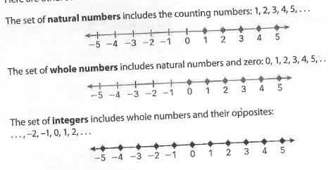
E
When a number is a fraction, to what set(s) of rational numbers does it NOT belong?
When a number is negative, to what set(s) of rational numbers does it NOT belong?

Slide 5
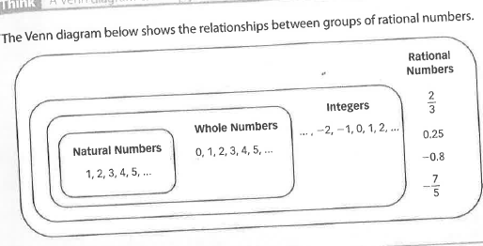
Notice the “nesting” nature of the diagram. For example, the set of natural numbers is nested completely within the set of whole numbers, which means that every natural number is also a whole number. But not every whole number is a natural number. Every whole number is an integer but not every integer is a whole number.

Slide 6
On a number line negative numbers are to the left of 0, while the positive numbers are to the right of 0. Natural and whole numbers are to the right of 0, but integers and rational numbers are to both the left and right of 0.
Remember: numbers that can only be written as decimals or fractions are never integers

Slide 7
Video

Slide 8
Activity
In each corner of the room there is a sign either labeled “Natural Numbers,” “Whole Numbers,” “Integers,” and “Rational Numbers.”
You will be given an index card with a number on it.
You must look at your number and determine which sign most specifically describes your number.
Take your number and stand near the sign where you think your number belongs.

